Slide 1

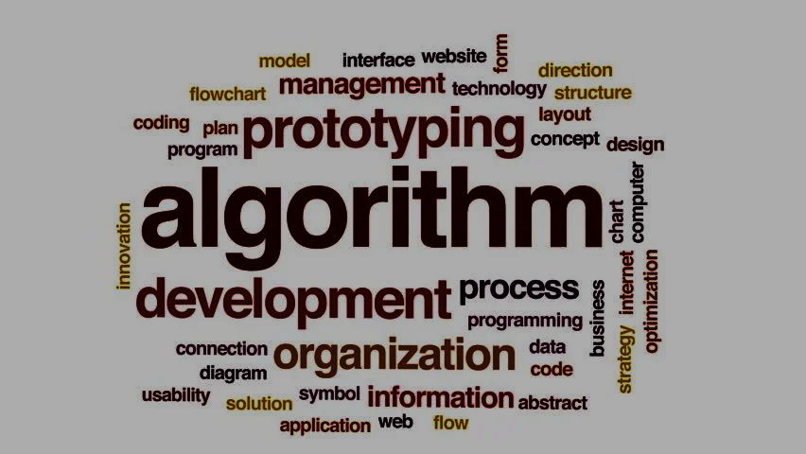
Algorithm in computer science

Slide 2
Introduction to algorithm
Definition
Set of rules to be followed using a program (or) procedure to solve or execute a problem is known as algorithm

Slide 3

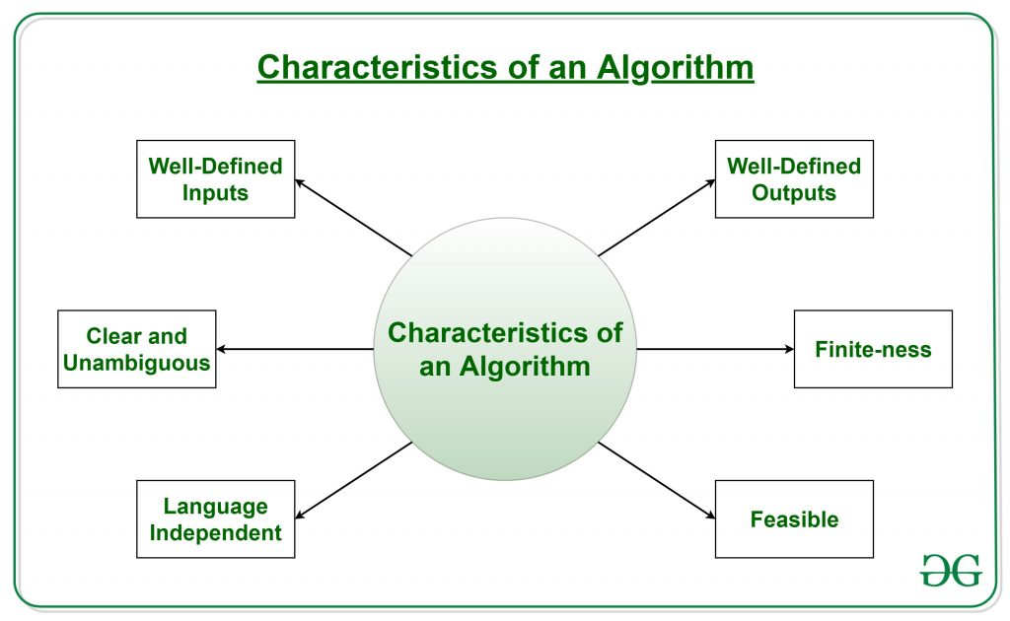
Characteristic of algorithm

Slide 4
Characteristic of algorithm
1.well defined input
If there is an algorithm to be solved there will be requirement of specific inputs ,the input should be in way that its should well defined according to the algorithm given or to be solved.
2.well defined output
The algorithm OUTPUT should be well defined and well yielded
3.clear and ambiguous
Each and every step in the algorithm must clear to avoid any error and all the algorithm must lead to a single output

Slide 5
Characteristic of algorithm
4.finite
The program should in finite runnable loops or steps
5.language independent
The algorithm must explain the instruction given in any other language and give the same output
6.feasibility
the algorithm should not be so complex ,it should easy to understand and execute

Slide 6
Types of algorithm
algorithms
Brute force
recurcive
Backtracking
Searching
Sorting
Hashing
Divide and conquer
Greedy
Dynamic programming
Randamized

Slide 7
Types of algorithm
Brute force algorithm
it is a simplest way of algorithm for any problem .brute force algorithm can be used for the simplest problems .
Recursive algorithm
recursive algorithm ,it works under recursion where a program is dived into segment and loops again and again for the same condition.
Backtracting algorithm
backtracting is an algorithm which check all the solution given if any of the condition goes fail it backtrack and moves on with next solution

Slide 8
Types of algorithms
Searching algorithm
searching algorithm help in find an element in given array or any kinda code .
Sorting algorithm
sorting algorithm is used where a given string or array needed to be sorted based on the given condition . The string or the array must be arranged in an order

Slide 9
Types of algorithm
hashing algorithm
it is same like searching algorithm but here hashing algorithm displaces the also shows the location of the data given.
Divide and conquer Algorithm
in this algorithm the program or code are divided into subsegments and each segment are solved separately and they are combined together to give the output

Slide 10
Types of algorithm
Greedy algorithm
greedy Algorithm is an algorithm which is done part by part and choose the part which gives more benefits
dynamic program algorithm
this Algorithm solve the program by overlapping and avoids Repetitive calculation
Randomised algorithm
this Algorithm uses random variables to decide what to do next

Slide 11
Creating algorithm
start
input
Declare
Input from user
Process based on question
Output statement
end

Slide 12




Algorithm design and tecnique
Different ways of algorithm
Implementation method
Design method
Design approch
Top-bottom approch
Recrusive and iteration
Other classifiactions
Bottom-top
Extract and approximation
Serial or parallel or distribution
Greedy method
Divide and conquer
Dynamic programming
Linear programming
reduction
Randomization
complexity
Resereach area
Enumeration and backtracking
Recursive call itself till the condition becomes true
Iteration used in loops like program
Extract finds the optimal solution for the problem
If there no any optimal solution approximation occurs
In serial the all the process occur in same time
In parallel all the processes are divided and work in different process time
In distribution process is divided and work in same time but different processor
Using the local optimal solution without thinking the future consequences
It divided the program and executes it and again combines
Its avoid the repeated result to see the time complexicity
Max and minimization of linear inputs
Using a optimal solution and reducing the problem
the program divided in sub program and repeating this process until its solved
A part of complex program is solved using programming language and combined into completed program
Choosing arandom variable to solve the promblem
Using time complexity soving the problem
Specific areas for specific problem
Backtracking the false element and enumerating it

Slide 13
why Analysis of algorithm is important
Predicting an algorithm without implementing in a computer
It is convinent to predict before instead of checking everytime and running it
It is impossible to predict an exact code.
Analysis of algorithm is approximate way of prediction
Analysising with different algorithm can give you the best solution

Slide 14
Types Analysis of algorithm
Best case
Taking the input which are easy to be solved and takes short time
Average case
Taking input randomly and checking its computing time
Worst case
Taking inputs that doesn’t exist or take long time to solve

Slide 15
Analysis of algorithm
Asymptotic analysis
Best,worst,avg
Asymptotic notation
Analysis of loops
Analysis of recurrence
Amortized analysis introduction
the analysis is done in term of the input given
Best case is done by giving input which takes less time
Worst case is done by giving input which takes more time
Avg is done by randomly taking input and computing the timetaken
It uses mathmatical terms
Theta notation enclose from lower and upper bound
Big o notation definies the upper bound of algorithm
Ω notation provides an asymptotic lower bound.
0(1)
0(n)
0(n^C)
O(logn)
O(loglogn)
If there no loop in the code
If the loop variable is incremented or decremented using constant variable
The time complexity of nested loop is equal to the no of time od execution of the innermost statement
If the loop variable is divided/multiplied by constant amount
If the loop variable is reduced or increased by constant exponents
substitution
Recurrence tree
Master method
Taking a assumption and by mathematical induction cheaking its true or not
By recurrence tree calculating time complexity of each level of tree and suming it up
It is a direct method
Only 3 cases can solved using this method
1. If f(n) = O(n^{c}) where c < Log_{b}a then T(n) = Θ(n^{Logba})
2. If f(n) = Θ(n^{c}) where c = Log_{b}a then T(n) = Θ(n^{c}Log n)
3.If f(n) = Ω(n^{c}) where c > Log_{b}a then T(n) = Θ(f(n))
analyze a sequence of operations and guarantee a worst-case average time that is lower than the worst-case time of a particularly complex operation.

Slide 16
Types of algorithms
Types
Sorting
searching
greedy
Dynamic
Pattern search
backtracking
Divide and conquer
mathematical
geometric
bitwise
Graph data structure
Randomize
Branch and bound
sorting algorithm is used where a given string or array needed to be sorted based on the given condition .
sorts an array by repeatedly finding the minimum element from unsorted part and putting it at the beginning.
greedy Algorithm is an algorithm which is done part by part and choose the part which gives more benefits
this Algorithm solve the program by overlapping and avoids Repetitive calculation
algorithms search a string within another string.
check all the solution given if any of the condition goes fail it backtrack and moves on with next solution
each segment are solved separately and they are combined together to give the output
a description of a set of steps that can be used to solve a mathematical computation.
These algorithms are designed to solve Geometric Problems.
The Bitwise Algorithms is used to perform operations at the bit-level or to manipulate bits in different ways.
A Graph consists of a finite set of vertices(or nodes) and set of Edges which connect a pair of nodes.
this Algorithm uses random variables to decide what to do next
used for solving combinatorial optimization problems These problems are typically exponential in terms of time complexity and may require exploring all possible permutations in worst case.

Slide 17
Methods with examples
Sorting
Example
{2, 3, 2, 4, 5, 12, 2, 3, 3, 3, 12}, then modify the array to {3, 3, 3, 3, 2, 2, 2, 12, 12, 4, 5}.
Answer
algorithm :Create a binary search tree and while creating BST maintain the count i,e frequency of each coming element in binary serch tree
Do Inorder traversal of binary search and store every element and count of each element in an auxiliary array.
Sort according to frequency of the elements.
Traverse through the sorted array .

Slide 18
Example for searching
Input: arr[] = {10, 20, 30, 50, 60, 80, 110, 130, 140, 170}, x = 110 Output: 6 Explanation: Element x is present at index 6.
Answer
Algorithm
Starting with mid element as a search key of a array.
If the value of the search key is equal to the item then return an index of the search key.
if the value of the search key is less than the item in the middle of the interval, reduce the interval or the array to the lower half or else to the upper half.
Repeatedly check from the second point until the value is found or the interval is empty.

Slide 19
Example for greedy algorithm
Algorithm :Create a leaf node for each unique character and build a min heap of all leaf nodes
Extract two nodes with the minimum frequency from the min heap.
Create a new internal node with a frequency equal to the sum of the two nodes frequencies. Make the first extracted node as its left child and the other extracted node as its right child. Add this node to the min heap.
Repeat steps#2 and #3 until the heap contains only one node. The remaining node is the root node and the tree is complete.

Slide 20
Dynamic algorithm example
Travelling salesman
Algorithm
Consider city 1 as the starting and ending point.
Generate all (n-1)! Permutations of cities.
Calculate the cost of every permutation and keep track of the minimum cost permutation.
Return the permutation with minimum cost.

Slide 21
Pattern searching algorithm
algorithm
Search word in two grid character
String matching where one string contains wildcard characters.
Suffix Tree Application 1 – Substring Check
Suffix Tree Application 2 – Searching All Patterns.

Slide 22
Backtracking method
algorithm
Generate all possible configurations of vertices and print a configuration that satisfies the given constraints.
Create an empty path array and add vertex 0 to it. Add other vertices, starting from the vertex 1. Before adding a vertex, check for whether it is adjacent to the previously added vertex and not already added. If we find such a vertex, we add the vertex as part of the solution. If we do not find a vertex then we return false.

Slide 23
Divide conquere method
algorithm
Break the given problem into subproblems of same type.
Recursively solve these subproblems
Appropriately combine the answers

